Slide 1
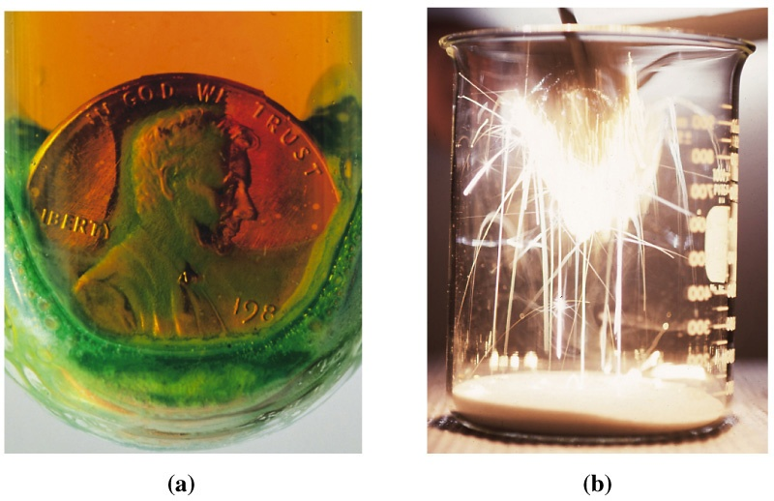
Chapter 4: Chemical Reactions
General Chemistry
Principles and Modern Applications
Notes:
Chemistry 140 Fall 2002
Iron rusts
Natural gas burns
Represent chemical reactions by chemical equations.
Relationship between reactants and products is STOICHIOMETRY
Many reactions occur in solution-concentration uses the mole concept to describe solutions

Slide 2

Contents
4-1 Chemical Reactions and Chemical Equations
4-2 Chemical Equations and Stoichiometry
4-3 Chemical Reactions in Solution
4-4 Determining the Limiting reagent
4-5 Other Practical Matters in Reaction Stoichiometry
Focus on Industrial Chemistry

Slide 3
Chemical Reactions and
Chemical Equations
A chemical reaction is a process in which one set of substances, called reactants, is converted to a new set of substances, called products.
In otherwords, a chemical reaction is the process by which a chemical change occurs.

Slide 4
4-1 Chemical Reactions and
Chemical Equations
As reactants are converted to products we observe:
  Color change
  Precipitate formation
  Gas evolution
  Heat absorption or evolution
Chemical evidence may be necessary.

Slide 5
Chemical Reaction
In a chemical equation, formulas for the reactants are written on the left side of the equation and formulas for the products are written on the right. The two sides of the equation are joined by an arrow. We say that the reactants yield the products.
Nitrogen monoxide + oxygen → nitrogen dioxide
Step 1: Write the reaction using chemical symbols.
Step 2: Balance the chemical equation.
2
1
2
NO + O₂ → NO₂
Notes:
Chemistry 140 Fall 2002
Consider the reaction of colorless nitrogen monoxide with oxygen to give brown nitrogen dioxide.
The arrow represents a reaction proceeding
Replace the words with chemical symbols

Slide 6
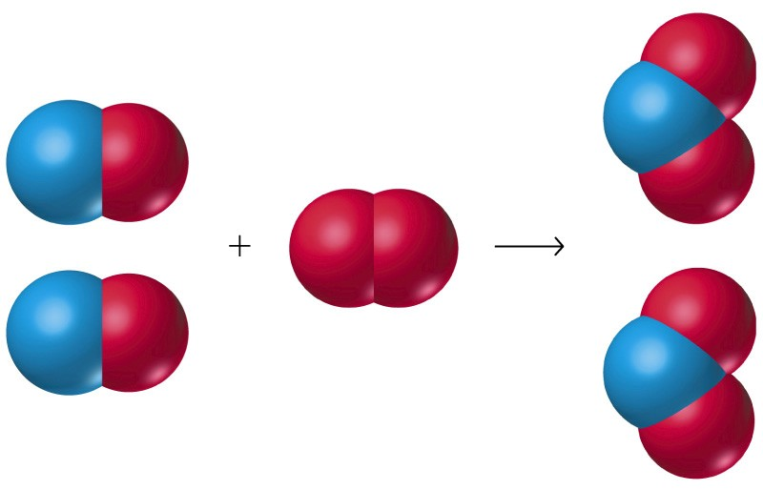
Molecular Representation

Slide 7
Balancing Equations
Never introduce extraneous atoms to balance.
NO + O₂ → NO₂ + O
Never change a formula for the purpose of balancing an equation.
NO + O₂ → NO₃

Slide 8
Balancing Equation Strategy
Balance elements that occur in only one compound on each side first.
Balance free elements last.
Balance unchanged polyatomics as groups.
Fractional coefficients are acceptable and can be cleared at the end by multiplication.

Slide 9
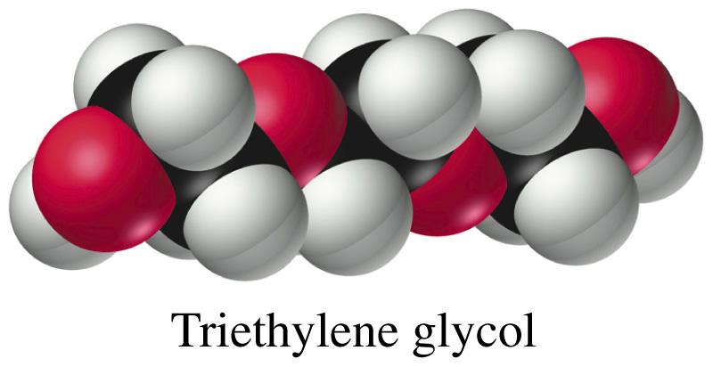
Example 4-2
Writing and Balancing an Equation: The Combustion of a Carbon-Hydrogen-Oxygen Compound.
Liquid triethylene glycol, C₆H₁₄O₄, is used a a solvent and plasticizer for vinyl and polyurethane plastics. Write a balanced chemical equation for its complete combustion.

Slide 10
Example 4-2
Chemical Equation:
15
6 7
C₆H₁₄O₄ + O₂ → CO₂ + H₂O
6 7
6
2
1. Balance C.
2. Balance H.
3. Balance O.
4. Multiply by two
2 C₆H₁₄O₄ + 15 O₂ → 12 CO₂ + 14 H₂O
and check all elements.

Slide 11
4-2 Chemical Equations and Stoichiometry
Stoichiometry includes all the quantitative relationships involving:
  atomic and formula masses
  chemical formulas.
Mole ratio is a central conversion factor.

Slide 12
Example 4-3
Relating the Numbers of Moles of Reactant and Product.
How many moles of H₂O are produced by burning 2.72 mol H₂ in an excess of O₂?
Write the Chemical Equation:
Balance the Chemical Equation:
2
H₂ + O₂ → H₂O
2
Use the stoichiometric factor or mole ratio in an equation:
2 mol H₂O
n_{H2O} = 2.72 mol H₂ × = 2.72 mol H₂O
2 mol H₂

Slide 13
Example 4-6
Additional Conversion Factors ina Stoichiometric Calculation: Volume, Density, and Percent Composition.
An alloy used in aircraft structures consists of 93.7% Al and 6.3% Cu by mass. The alloy has a density of 2.85 g/cm³. A 0.691 cm³ piece of the alloy reacts with an excess of HCl(aq). If we assume that all the Al but none of the Cu reacts with HCl(aq), what is the mass of H₂ obtained?

Slide 14
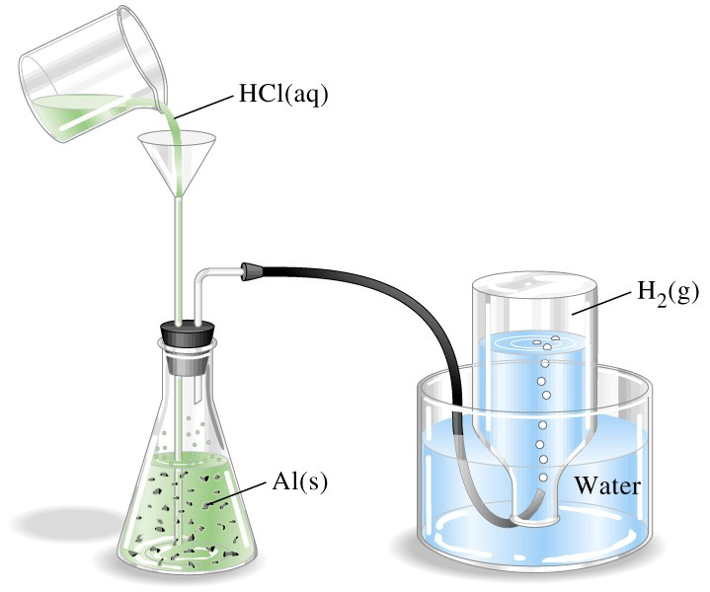
Example 4-6
Write the Chemical Equation:
Balance the Chemical Equation:
2
Al + HCl → AlCl₃ + H₂
6
2
3

Slide 15
Example 4-6
2 Al + 6 HCl → 2 AlCl₃ + 3 H₂
Plan the strategy:
cm³ alloy → g alloy → g Al → mole Al → mol H₂ → g H₂
We need 5 conversion factors!
Write the Equation
and Calculate:
2.85 g alloy
97.3 g Al
m_{H2} = 0.691 cm³ alloy × × ×
1 cm³
100 g alloy
1 mol Al
3 mol H₂
2.016 g H₂
× ×
= 0.207 g H₂
26.98 g Al
2 mol Al
1 mol H₂

Slide 16
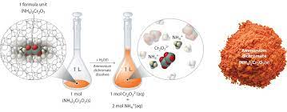
4-3 Chemical Reactions in Solution
Most reactions in the general chemistry laboratory are carried out in solutions. This is partly because mixing the reactants in solution helps to achieve the close contact between atoms, ions, or molecules necessary for a reaction to occur.

Slide 17
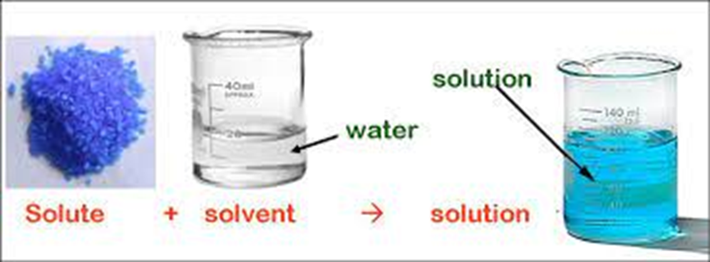
4-3 Chemical Reactions in Solution
One component of a solution, called the solvent, determines whether the solution exists as a solid, liquid, or gas. In this discussion we will limit ourselves to aqueous solutions-solutions in which liquid water is the solvent. The other components of a solution, called solutes, are dissolved in the solvent.

Slide 18
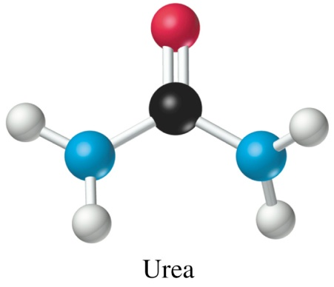
Molarity
Amount of solute (mol solute)
Molarity (M) =
Volume of solution (L)
The composition of a solution may be specified by giving its molarity, which is defined as the amount of solute, in moles, per liter of solution:
If 0.444 mol of urea is dissolved in enough water to make 1.000 L of solution the concentration is:
0.444 mol urea
c_{urea} =
= 0.444 M CO(NH₂)₂
1.000 L

Slide 19

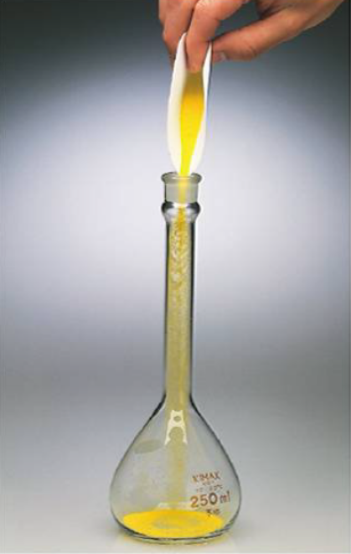
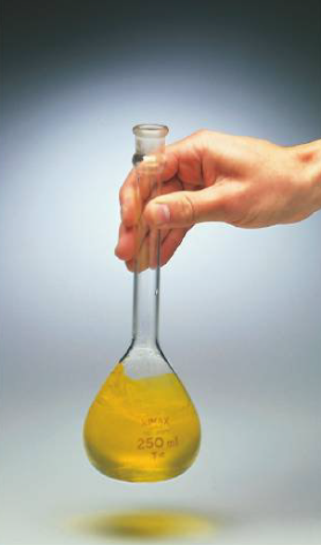
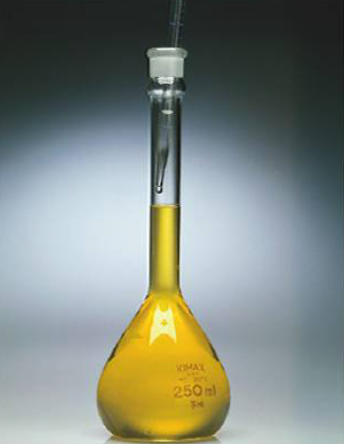
Preparation of a Solution
Weigh the solid sample.
Dissolve it in a volumetric flask partially filled with solvent.
Carefully fill to the mark.

Slide 20
Example 4-6
Calculating the mass of Solute in a solution of Known Molarity.
We want to prepare exactly 0.2500 L (250 mL) of an 0.250 M K₂CrO₄ solution in water. What mass of K₂CrO₄ should we use?
Plan strategy:
Volume → moles → mass
We need 2 conversion factors!
Write equation and calculate:
0.250 mol
194.02 g
m_{K2CrO4} = 0.2500 L × × = 12.1 g
1.00 L
1.00 mol

Slide 21
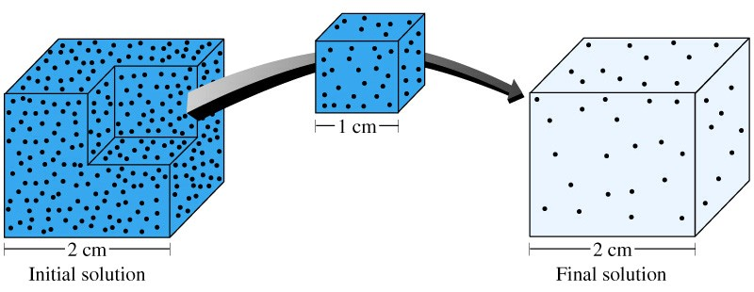
Solution Dilution
M_{i} × V_{i}
M_{f} × V_{f}
n
M =
V
A common sight in chemistry storerooms and laboratories is rows of bottles containing solutions for use in chemical reactions. It is not practical, however, to store solutions of every possible concentration.
Instead, most labs store fairly concentrated solutions, so-called stock solutions, which can then be used to prepare more dilute solutions by adding water.

Slide 22
Solution Dilution
M_{i} × V_{i}
M_{f} × V_{f}
n
M =
V
M_{i} × V_{i} = n_{i}
= n_{f} = M_{f} × V_{f}
M_{i} × V_{i}
V_{i}
M_{f} =
= M_{i}
V_{f}
V_{f}

Slide 23
Example 4-10
Preparing a solution by dilution.
A particular analytical chemistry procedure requires 0.0100 M K₂CrO₄. What volume of 0.250 M K₂CrO₄ should we use to prepare 0.250 L of 0.0100 M K₂CrO₄?
V_{i}
M_{f}
Plan strategy:
M_{f} =
M_{i}
V_{i} =
V_{f}
V_{f}
M_{i}
Calculate:
0.0100 mol
1.000 L
V_{K2CrO4} = 0.2500 L × × = 0.0100 L
1.00 L
0.250 mol

Slide 24
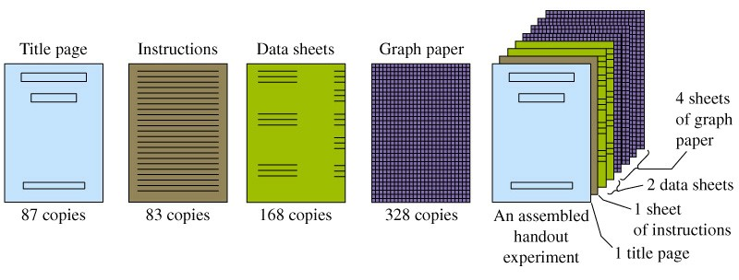
4-4 Determining Limiting Reagent
When all the reactants are completely and simultaneously consumed in a chemical reaction, the reactants are said to be in stoichiometric proportions; that is, they are present in the mole ratios dictated by the coefficients in the balanced equation. This condition is sometimes required, for example, in certain chemical analyses.
At other times, as in a precipitation reaction, one of the reactants is completely converted into products by using an excess of all the other reactants. The reactant that is completely consumed -the limiting reactant- determines the quantities of products formed.

Slide 25
Example 4-12
Determining the Limiting Reactant in a Reaction.
Phosphorus trichloride , PCl₃, is a commercially important compound used in the manufacture of pesticides, gasoline additives, and a number of other products. It is made by the direct combination of phosphorus and chlorine
P₄ (s) + 6 Cl₂ (g) → 4 PCl₃ (l)
What mass of PCl₃ forms in the reaction of 125 g P₄ with 323 g Cl₂?
Strategy:
Compare the actual mole ratio to the required mole ratio.

Slide 26
Example 4-12
1 mol Cl₂
n_{Cl2} = 323 g Cl₂ × = 4.56 mol Cl₂
70.91 g Cl₂
1 mol P₄
n_{P4} = 125 g P₄ × = 1.01 mol P₄
123.9 g P₄
χ_{actual} = 4.55 mol Cl₂/mol P₄
χ_{theoretical} = 6.00 mol Cl₂/mol P₄
n
χ =
Cl₂
n
P₄
Chlorine gas is the limiting reagent.

Slide 27
4-5 Other Practical Matters in
Reaction Stoichiometry
Theoretical yield is the expected yield from a reactant.
Actual yield is the amount of product actually produced.
Actual yield
Percent yield = × 100%
Theoretical Yield

Slide 28
Theoretical, Actual and Percent Yield
When actual yield = % yield the reaction is said to be quantitative.
Side reactions reduce the percent yield.
By-products are formed by side reactions.

Slide 29
Consecutive Reactions,
Simultaneous Reactions and
Overall Reactions
Multistep synthesis is often unavoidable.
Reactions carried out in sequence are called consecutive reactions.
When substances react independently and at the same time the reaction is a simultaneous reaction.

Slide 30
Overall Reactions and Intermediates
The Overall Reaction is a chemical equation that expresses all the reactions occurring in a single overall equation.
An intermediate is a substance produced in one step and consumed in another during a multistep synthesis.

Slide 31
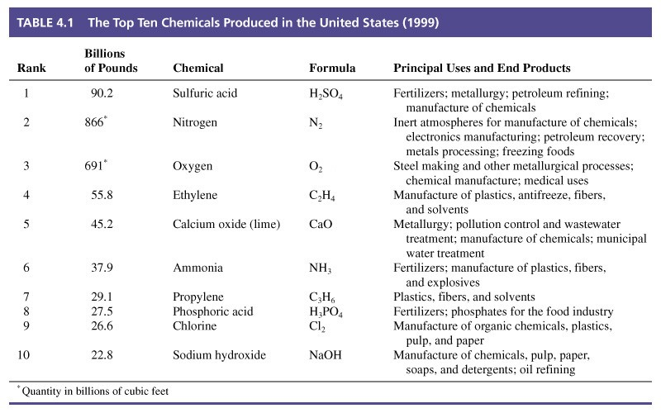
Focus on Industrial Chemistry

